Slide 1


Pricing for Seasonality
Written & Presented By: James R. Leichter

Slide 2
Income Statement Basics

Slide 3
Income Statement Basics – Terms to Know and Understand
Income: Also referred to as Sales or Revenue. Revenue is the total amount of money collected for goods and services sold before subtracting any expenses. It also includes any credits or discounts for returned sales.
Cost of Goods Sold: Also known as Direct Expenses or Direct Costs. Costs incurred that can be directly attributed to, and associated with, selling goods and services. They are sometimes broken down into two main categories: labor and MESO (materials, equipment, sub-contractors, and other). Examples may include sheet metal, furnaces, and installation labor.
Unapplied Labor: The amount paid to the direct labor force but is not charged to jobs.
Gross Profit: This is the amount of money you profit on something you sell using direct cost only. This ignores the effect of other expenses in determining the markup rate.
MESO: Materials, equipment, sub-contractors, and other direct expenses. Basically, all cost of goods sold except for labor related COGS.

Slide 4
Income Statement Basics – Terms to Know and Understand
Overhead: Expenses that cannot be attributed to an individual item of output, such as utilities, rent, etc. Please also see variable and fixed overhead.
Variable Overhead: Variable overhead represents expenses that generally increase/decrease, to a significant degree, in proportion to a sales increase/decrease. Examples are workman’s compensation/ general liability insurance, certain other insurance, payroll taxes, bonuses, vacation pay, pension funds, profit sharing, etc.
Fixed Overhead: Same meaning as Fixed Costs. Expenses (costs) that do not change within a so called “specific trading range” for a given period of time, despite fluctuations in activity. Examples include rent, office salaries, telephone service, utilities, and others.
Contribution Margin: This is equal to gross profit dollars less variable overhead. This money contributes to paying fixed costs and producing a net profit.
Net Profit Before Taxes (NPBT): The excess of income over costs and expenses of a business.

Slide 5
Income Statement Basics
Income Statement Example (very simplified)
Net Income $5,000,000
Cost of Goods Sold $2,750,000 (55%)
Gross Profit $2,250,000 (45%)
Overhead
Marketing $ 100,000
Employee Related $ 890,000
Plant and Equipment $ 175,000
Vehicle Related $ 225,000
Administration $ 350,000
Interest $ 10,000
Total Overhead $1,750,000 (35%)
Net Profit Before Taxes $ 500,000 (10%)
This is an over simplified Income Statement for training purposes.
Your company needs far greater detail.
Income, cost of goods sold, and overhead should be broken out into more detailed descriptions.

Slide 6
Income Statement Basics
Income Statement with Fixed and Variable Overhead Expenses
Net Income $5,000,000
Cost of Goods Sold $2,750,000 (55%)
Gross Profit $2,250,000 (45%)
Overhead
Variable $ 750,000 (15%)
Fixed $1,000,000
Total Overhead $1,750,000 (35%)
Net Profit Before Taxes $ 500,000 (10%)
Contribution Margin = $1,500,000. That’s used to pay the fixed overhead. If there is any money left over, it is called net profit before taxes.
Here we breakout our overhead expenses by fixed and variable.
This is an oversimplified example. Normally there would be greater detail.
This gives us more information to help with pricing jobs accurately.

Slide 7
Understanding the Concept of Break-Even and
its Importance to Contracting Companies

Slide 8
Understanding Break-Even
Sales Break-Even Point
The sales break-even point is a point in time when total costs are equal to total revenue. In other words, total gross profit dollars are equal to total overhead.
Knowing the break-even point can help businesses understand how much of a product or service they must sell to produce a profit. Break-even points can also help establish goals for sales teams and drive productivity.
The formula for Break-Even Point can be described as follows:
Break-Even Point Formula = Fixed Costs / (Gross Profit % - Variable Overhead %)
Fixed costs are in a dollar amount and the gross profit margin is in decimal form. The resulting answer is also in a dollar amount. For example, if your total fixed costs for the year were $1,000,000, gross profit margin was 45%, and variable overhead is 15%, your break-even point is $3,333,333.33 in total sales.
1,000,000.00 / (.45 - .15) = 3,333,333.33

Slide 9
Understanding Break-Even
Break-Even Price
The break-even price is the amount of money that you must sell a product for to make exactly zero dollars, including materials and other costs such as labor, utilities, etc. This is used as a starting point for determining retail price based on a given markup. This can be the price of an item, hour of labor, flat rate task, system tune-up, or a large multi-day job.
The formula for break-even price can be described as follows:
Break-Even Price Formula =
(Fixed Overhead / Production Volume) + (Cost of Goods Sold + Variable Overhead)
Please Note: “Production Volume” for contractors usually means “how many we have available to sell.”
Let’s look at an example of this:

Slide 10
Understanding Break-Even
Break-Even Price Example
In this example, our Production Volume is 5000 hours of labor. It could have been anything including 500 water heaters, 2500 service calls, or 750 person-days.
The Variables:
Fixed Overhead = $1,000,000
Production Volume* = 5000
Cost of Goods Sold (COGS) = 55% (could be expressed as dollars)
Variable Overhead = 15%
The Math:
$1,000,000 / 5000 = $200
$200 x ((1 + 0.55) + (1 + 0.15)) = $350
$350.00 is your break-even price on one hour of labor, as long as you sell 5000 of them.
*Available Hours of Labor to Sell

Slide 11
Recapping Some General Concepts
The Power of Breakeven
(Income – Cost of Goods Sold) = Gross Profit
(Gross Profit - Variable Overhead) = Contribution Margin
(Contribution Margin – Fixed Overhead) = Net Profit Before Taxes
When contribution margin dollars cover your fixed overhead, you are at your breakeven point. Every single contribution margin dollar becomes net profit.
Knowledge is Power
Imagine the power of knowing the exact day of each month where your company breaks even. Based on facts, you can offer discounts to fill unused capacity or turn down low-profit work in favor of something more beneficial. You can offer performance or profit based bonuses with high confidence that you will not be hurting yourself.

Slide 12
Departmentalized Income Statements are Essential.
They are Also Required for Accurate Price Calculations.

Slide 13
The Importance of Departmentalized Financials
The Importance of Departmentalized Income Statements
In the context of financial reporting, “Departments” can also be correctly referred to as “Profit Centers.”
You need the ability to print your company’s income statements by department. That will give you the ability to quickly examine your Direct Labor to Sales KPI (among many other important things).
I recommend that you set up your divisions and departments according to EGIA (and Aptora) recommendations. Those recommendations can be found on the EGIA website.
Using specialized accounting software, you will not only be able to see the gross profit of each department, but you will also be able to see the overhead and net profit of each department within your company. This is necessary for a full understanding of where your company stands in this time of unprecedented uncertainty.

Slide 14
The Importance of Departmentalized Financials
Departments versus Divisions
Divisions are not always needed. They should be used when the company finds itself needing to duplicate the name of a department but under a different management group or industry segment.
Common divisions include Residential and Commercial.
Please don’t confuse organization departments (or organizational structure) with financial departments.
  Example: Your company might have a marketing department, but not a profit center called “marketing.”

Slide 15
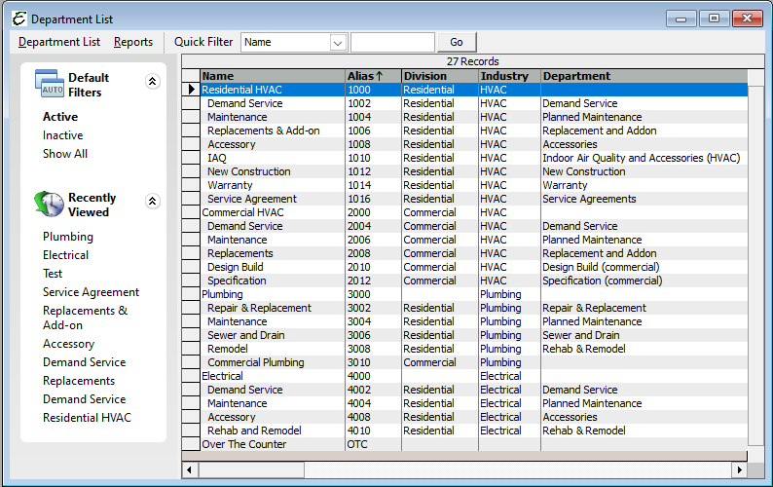
The Importance of Departmentalized Financials
Create a good list of divisions and departments for excellent financial tracking and total accountability.
Division and Department Setup Example.
Credit: Aptora’s Total Office Manager®

Slide 16
Putting Break-Even to Work by Department

Slide 17
Applying Break-Even Formulas by Department
Break-Even Price for Installation Work
In this example, our Production Volume is 750 person-days. We have determined that we have 750 installation days to sell in one year. This might be three installers, each offering 250 days per year.
The Variables:
Fixed Overhead = $1,000,000
Production Volume* = 750
Cost of Goods Sold (COGS) = 55% (may also be expressed as dollars)
Variable Overhead = 15%
The Math:
$1,000,000 / 750 = $1,333,33
$1,333,33 x ((1 + 0.55) + (1 + 0.15)) = $2,266.67
In this example, you company needs to collect $2,266.67 per day in installation revenue to break even and make zero net profit.
*Available Hours of Labor to Sell

Slide 18
The Information Needed to Determine
Break-Even for Each of Your Departments

Slide 19
Demand Service Department Pricing
Gathering the Required Information
You must know exactly how to price demand service if you wish to avoid a financial disaster. This department is where most companies lose money.
Remember, it is the costs associated with labor that will kill you.
Here are the things you will need:
The number of service technicians.
The available number of labor hours that can be sold.
The service department income statement.
Your billable hours efficiency (sold versus paid).
The number of labor hours you expect to sell.
The number of service calls you expect to sell (perform).

Slide 20
Installation and Replacement Department Pricing
You Need to Know Four Numbers
You must have a good idea how to price replacement and installation work if you wish to avoid financial pain.
You must markup equipment, materials, and labor properly to arrive at a correct selling price. Remember, it is the labor that can kill you.
Here are the four things you need:
The overhead for the department. If you must, you can use the company’s total.
The labor sales for the department.
The MESO sales for the department.
Your desired net profit before taxes (NPBT).

Slide 21
Make it Easy with Specialized Calculators

Slide 22
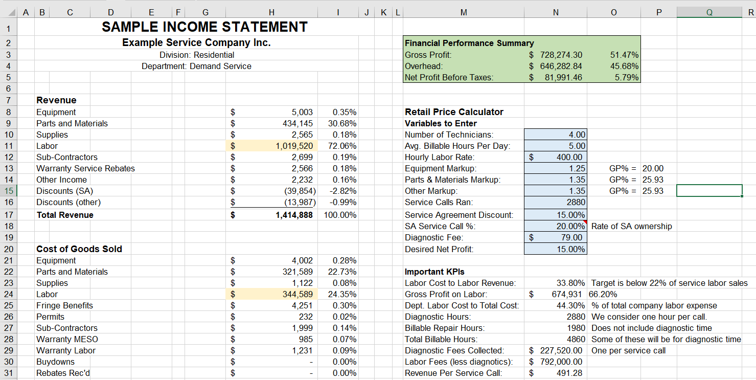
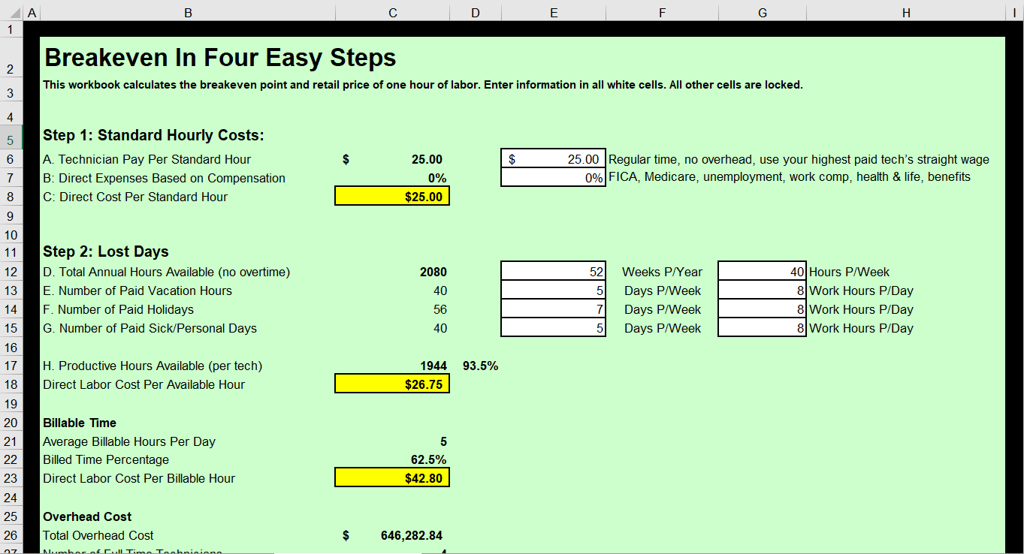
Demand Service Price Calculators
Using Specialized Calculators
We will use two types of calculators to determine our labor and MESO markups for the demand service department. This method also applies to maintenance work.

Slide 23
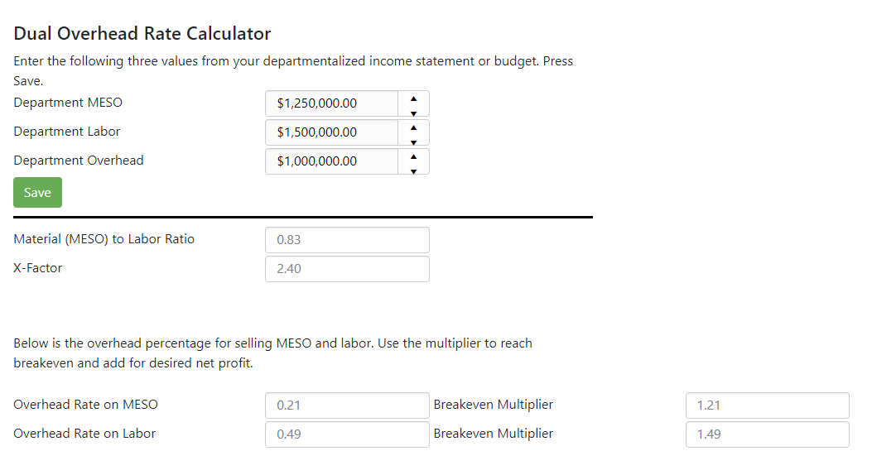
Installation and Replacement Price Calculator
Using the Dual Overhead Calculator
Use a specialized calculator for determining the correct markup on labor and MESO.
This calculator may be used for free at: https://my.flatratesoftware.com/toolbox/dualratecalculator

Slide 24
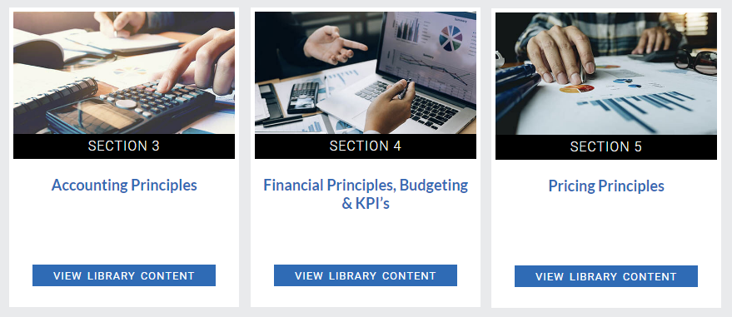
Free Price Calculators
Price Calculators at Contractor University Website
They are part of your resource library and free to members.
EGIA Contractor University® Resource Library: https://library.mycontractoruniversity.com/

Slide 25
Determining How Much Net Profit to Add

Slide 26
Deciding on Net Profit
Net Profit by Department
The NPBT amount might depend on how difficult or labor intensive the work is within that department. It may also depend on how busy your company is. In our opinion, demand service needs to demand the highest net profit. Don’t forget about “loss leaders”.
Demand Service*
Replacement and Add-on
New Construction
Tune-ups as Loss Leaders
Service Agreements
Commercial versus Residential
*IMPORTANT: Be sure to factor in the discounts you offer service agreement owners. Your retail pricing must be able to overcome that added cost, to produce the desired net profit before taxes (NPBT).

Slide 27
Deciding on Net Profit
Net Profit Based on Demand
The power or break-even gives you the ability to vary your prices based on demand.
For many contracting companies, it is extremely difficult to add significant capacity. Increasing prices is often a better option.
When your company (or a particular department) is very busy, you can either increase production to meet demand or increase net profit margins to align demand with production capacity.
By maximizing profits during periods of high demand, your company will have more cash to weather the slow seasons (shoulder period).
When your company (or a particular department) is slow, you can either layoff employees to preserve cash, keep employees on the payroll and destroy profits, or price jobs lower to increase demand.
Your company can sell jobs with net profit margins dialed in to control demand, keep employees on the payroll, and maximize profits when possible.
Great Tip: Be sure to add short expiration dates to your sales proposals. You can always extend them but cannot shorten them.

Slide 28
Remember These Four Rules
Remember there are three rules to creating a proper pricing method:
1. Markup Labor and MESO Separately
As we have learned, labor is the driver of overhead. It must carry the burden of covering most of your company’s overhead costs. It will always have a much higher markup.
2. Breakeven First
Your first objective with any pricing method is to achieve breakeven. This means you will not lose money selling an item at a given price and you will not make a profit. Your net profit will be 0.00%.
3. Decide on Net Profit Last
Once your markup method has achieved breakeven you will then add something more for NPBT (net profit before “income” taxes). Base this by department and customer demand.
4. Do All This by Department
Each department is very different from a financial perspective. You must perform these calculations by department. You will need departmentalized income statements.

Slide 29
The Low Overhead Myth
Small companies do not have low overhead. They cannot afford to sell things cheaper than bigger companies.
Big companies typically have lower overhead than small companies, when overhead is expressed as a percent of revenue.
Big companies have big buying power.
Big companies often pay less for most MESO than small companies.
Big companies often utilize tools and equipment more efficiently.
Don’t be fooled into thinking that you can charge less than a larger competitor, just because you are smaller.
The faster you start charging enough to pay for the things you need but don’t have, the sooner you will be able to afford the things you must have but can’t afford.

Slide 30
Thank you very much for watching.
-James R. Leichter
www.mrhvac.com

